Slide 1
Probability & Statistical Modelling
AQ077-3-2-PSMOD and Version VD1
Correlation & Regression Analysis

Slide 2
Topic & Structure of The Lesson
Introduction
Regression
Correlation

Slide 3
Learning Outcomes
At the end of this section, You should be able to:
Analyse bi-variate data using regression & correlation techniques used to measure the linear relationship between two variables.

Slide 4
Key Terms You Must Be Able To Use
If you have mastered this topic, you should be able to use the following terms correctly in your assignments and exams:
(Prepare your own list )
Regression equation
Least square
Slope
Y-intercept
Pearson product moment correlation
Coefficient of determination
Spearman rank correlation

Slide 5
Introduction
Correlation & Regression are concerned with measuring the linear relationship between two variables.
Scattergram is used to illustrate any relationship between two variables.

Slide 6
Correlation analysis is used to measure strength of the association (linear relationship) between two variables
Only concerned with strength of the relationship
No causal effect is implied

Slide 7
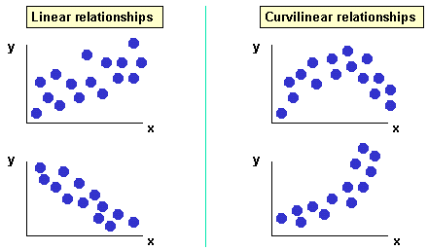
Examples of scatter plots

Slide 8
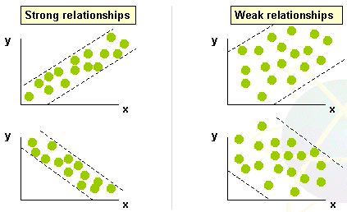

Slide 9
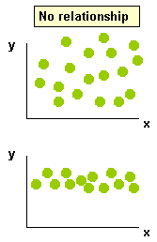

Slide 10
Regression
Regression in concerned with obtaining a mathematical equation which describes the relationship between two variables.
The independent variable is the one that is chosen freely or occurs naturally.
The dependent variable occurs as a consequence of the value of the independent variable.
It is normally used for estimation purposes.

Slide 11
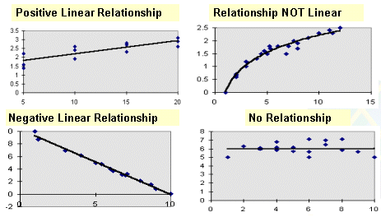
Types of Regression Models

Slide 12
3 common methods used to determine a regression line
inspection method
semi-average method
least square method

Slide 13
Least square method
the standard method of obtaining a regression line.
For any set of bivariate, there are two regression line which can be obtained
x on y regression line
used for estimating x given a value of y
y on x regression line
used for estimating y given a value of x.
Note that for this syllabus, only the y on x regression line is dealt with.

Slide 14
If the least square equation is given by
y= a + bx,
then,

Slide 15
Example 1
The following table shows the amount spent on advertising and the corresponding sales of the product from 6 companies.
Company | Advertising Cost ($000) | Sales ($000)
A | 8 | 25
B | 12 | 35
C | 11 | 29
D | 5 | 24
E | 14 | 38
F | 3 | 12

Slide 16
Plot a scattergram showing the relationship between advertising cost and sales of the product.
Calculate the equation of the regression line of sales on advertising costs. Draw the regression line on the scattergram.
Use the regression line to forecast sales if advertising costs were
(i) $10000
(ii) $1000
(d) Justify your answer in part (c)(ii).

Slide 17
Correlation
It is a technique used to measure the strength of relationship between two variables by measuring the degree of ‘scatter’ of the data values.
The less scatter the data values are, the stronger the correlation.
Two types of correlation
Positive (direct)
Negative (inverse)

Slide 18
Measures of correlation
Product moment correlation coefficient
Coefficient of determination
Spearman rank correlation coefficient

Slide 19
Product moment correlation coefficient, r
It measures the extent to which two variables move in sympathy with or in opposition to one another.

Slide 20
The correlation coefficient, r lies between 0 and ± 1.
When r = 0, it signifies there is no correlation present
When r = 1, it signifies perfect positive correlation
When r = -1, it signifies perfect negative correlation
The further away r is from 0, the stronger is the correlation.

Slide 21
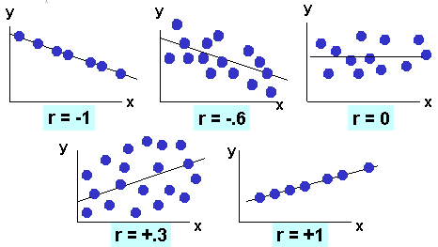
Examples of appropriate r values

Slide 22
Coefficient of determination, r²
It indicates the proportion of variance in the dependent variable that is explained statistically by knowledge of the independent variable and vice versa.
Notice that, since –1 ≤ r ≤ +1, it follows that 0 ≤ r² ≤ +1

Slide 23
Example 2
Use the data of Example 1, calculate the
(i) Product moment correlation coefficient
(ii) Coefficient of determination
and interpret the result.

Slide 24
Spearman rank correlation coefficient, r_{s}
It can be used:
as an approximation to the product moment coefficient
With non-numeric data that can be ranked

Slide 25
Procedure for obtaining r_{s}
Rank the x values, r_{x}
Rank the y values, r_{y}
For each pair of ranks, calculate d² =(r_{x} – r_{y})²
Calculate ∑d²
The value of the rank correlation coefficient can then be calculated as below:

Slide 26
Example 3
In a survey of TV viewers in Sabah and KL, the following programme were ranked in order of preference. Calculate the Spearman’s rank correlation coefficient for the data. Comment on the result.
TV programme | Sabah | KL
Biggest Loser | 1 | 2
Amazing Race | 2 | 5
TV3 news | 4 | 4
Hero | 3 | 6
24 | 5 | 1
CSI | 7 | 7
Ultraman | 6 | 3

Slide 27
Example 4
The following table shows the marks of eight pupils in biology and chemistry. Find the value of Spearman’s coefficient of rank correlation.
Biology (x) | 65 | 65 | 70 | 75 | 75 | 80 | 85 | 85
Chemistry (y) | 50 | 55 | 58 | 55 | 65 | 58 | 61 | 65

Slide 28
Comparison of rank and product moment correlation ( with (+) and (-) signifying whether the feature can be thought of as an advantage or disadvantage respectively)
Product moment coefficient
The standard measure of correlation (+)
Data must be numeric (-)
The calculations can be awkward. (-)

Slide 29
Rank coefficient
Only an approximation to the product moment coefficient. (-)
Easier to use with less involved calculations. (+)
Can be used with non-numeric data. (+)
Can be insensitive to small changes in actual values. (-)

Slide 30
Practical difficulties in drawing conclusions from correlation coefficient
A high correlation coefficient does not necessarily imply that the variables are related to one another- spurious correlation
A low correlation coefficient between two variables does not necessarily mean that there is little relationship between them but there are also some additional factors exerting an influence.

Slide 31
EXCEL
=SLOPE( )
=INTERCEPT( )
=PEARSON( )

Slide 32
Summary of Main Teaching Points
Regression
It is concerned with producing a mathematical function which describes the relationship between two variables. It is normally used for estimation purposes.

Slide 33
There are three common methods used to determine a regression line for a set of bivariate data.
Inspection
Method of semi-averages
Method of least squares.
This is the standard technique for obtaining a regression line.

Slide 34
In most examinations questions the bivariate variables involved will be labelled (usually x and y) and the regression line of y on x will be asked for. Where this is not the case, it is usual to label the independent variable as x and the dependent variable as y and thus the y on x regression line will be appropriate.
Please take note that
Other forms of regression are sometimes appropriate and calculated, e.g. curvilinear regression.

Slide 35
An independent variable can be affected by more than 1 dependent variable.
Interpolation involves estimating a value of the dependent variable given a value of the independent variable within the range of the data used to calculate the regression line and can be carried out with some confidence. Estimation outside this range is known as extrapolation and the results should be treated with caution.

Slide 36
Correlation
Concerned with describing how well two variables are associated by measuring the degree of ‘scatter’ of the data values.
Two types
Positive (direct)
Increases in one variable are associated with increases in the other.
Negative (inverse)
Increases in one variable are associated with decreases in the other.

Slide 37
A quantitative measure of correlation is given by the (product moment) correlation coefficient, r.
-1 ≤ r ≤ 1
r = - 1 signifies perfect negative correlation
r = 0 signifies no correlation
r = + 1 signifies perfect positive correlation
The product moment correlation coefficient is the standard measure of correlation for numeric data. It cannot be calculated for non-numeric data.

Slide 38
The coefficient of determination,r², is used to indicate the proportion of the total variation in the dependent variable (y) that is due to variations in the independent variable (x).
Spearman’s rank correlation coefficient can be used:
As an approximation to the product moment coefficient
With non- numeric data that can be ranked.
Correlation does not necessarily imply causality.

Slide 39
Question and Answer Session
Q & A

Slide 40
What we will cover next
Probability Distribution

